Slide 1
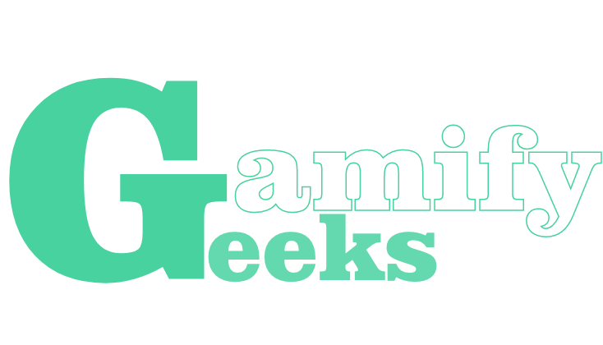
Conquer coding with AI-crafted tasks

Slide 2

Team + Sponsor
Joe Gaspari
[Project Manager]
Archita Gattani
[Technical Lead]
Jason Ramos
[Software Manager]
Gyumin Moon
[Integration Lead]
Alrick Vincent
[Client Liaison]
+
Learnification Technologies
[Parsa Rajabi]
Notes:
Learnification Technologies is a company started by an UBC Okanagan Alumni, Parsa Rajabi. Parsa’s goal with our product is to enhance the user learning experience by making coding problems easily accessible and fun. Our goal is to gamify this process reducing the barrier to enter as to attract as many prospective learners as possible.

Slide 3

Project Description & Goals
The project will focus on developing a dynamic web application that encourages users to practice coding in a gamified environment. The system will leverage Open AI’s API to generate questions based on language, topic and proficiency chosen by the user.
1.
To allow users the ability to generate practice questions when they want and in a style they feel comfortable with.
To allow students the ability to join classes that include assignments with questions curated by instructors that match up with course curriculum.
2.
3.
To allow instructors the ability to create classes and assignments with questions that align to their course curriculum.
Notes:
(((((
The primary objective of the project is to create an interactive online platform designed to simplify the process of learning and practicing programming skills. Users will have the opportunity to practice with AI-generated questions, tailored to their specific needs. These questions are created using OpenAI’s API and are based on parameters selected by the users, such as programming language, proficiency level, and difficulty.
In those three bullet points you can see the system’s main goals.
The overall goal is to create a points and badge system that will provide students and free learners the ability to level up as they complete more questions on the platform. This will incentivise the users to compete in a game like style.
))))

Slide 4





Key Specifications
Interactive Gamified Learning Platform
Role-based Features and Use Cases
Best Development and Deployment Practices
Responsive and Secure
Notes:
Interactive Learning Platform: Develop an accessible, gamified, interactive web-based platform for learning programming languages including JavaScript, Python, HTML/CSS, etc.) with AI-enabled practice questions, user progress tracking, and rewards systems to promote engagement.
Role-Based Features and use cases: We are planning to implement different secure user roles which will be discussed later in the presentation. Each role will have separate and common use cases for the website, with some even overlapping with each other.
Responsive and secure: Although we are not aiming to make the design accessible for mobile devices, we want to ensure a responsive design for non-mobile devices with robust user security, and both client and server-side security.
Development and Deployment Practices: Our aim for the development for this project is to adhere to best development practices respective to our tech-stack. This includes rigorous code documentation, Test-Driven-Development which will be described further in the testing strategy, the use of known and effective design patterns, as well as following a strict CI/CD workflow.

Slide 5




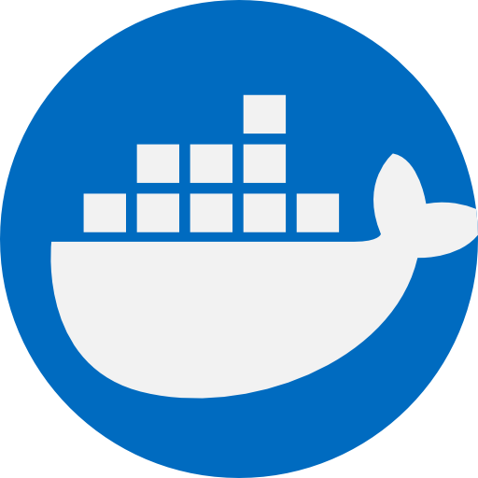


SERN Tech Stack
Notes:
Let's look at the technology stack powering our application, often referred to as the SERN stack. Each of these technologies plays a crucial role in our development and deployment process.
Starting with MySQL, represented by the dolphin icon, it's our choice for a relational database management system. It's responsible for data storage, retrieval, and maintaining data integrity. We chose MySQL over postgreSQL because it is highly efficient, free and open-source.
Next is Node.js, depicted by the green hexagonal logo. Node.js serves as our runtime environment for server-side JavaScript, acting as a bridge between our database and the user interface.
Express.js, depicted by the stylized "Express," works in tandem with Node.js to handle our server-side logic. It's a minimal and flexible Node.js web application framework that provides robust features for our web and mobile applications.
React, represented by the atom-like logo, is our chosen library for building the user interface. Its component-based architecture makes it ideal for developing scalable, modular and interactive web applications.
Tailwind CSS, with the wind-like logo, is our utility-first CSS framework for rapidly building custom user interfaces. It allows us to craft unique designs without leaving our HTML.
Express.js, depicted by the stylized "Express," works in tandem with Node.js to handle our server-side logic. It's a minimal and flexible Node.js web application framework that provides robust features for our web and mobile applications.
Lastly, encompassing all these technologies is Docker, represented by the whale carrying containers. Docker aids in simplifying our deployment process. It packages our application and its dependencies into a container, which can be run consistently on any platform.
Collectively, these technologies form a robust and efficient tech stack that allows us to deliver a high-performance, interactive web application."

Slide 6

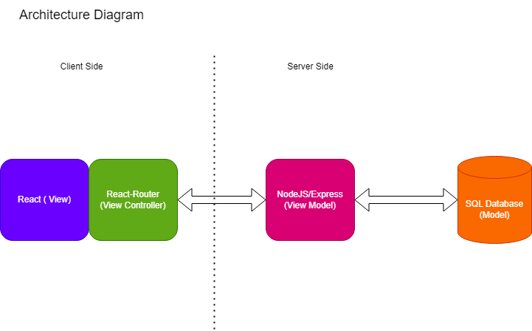
MVVM System Architecture
Notes:
SERN tech stack: SQL, Express, React, Node
MVVM Architecture: Our system follows the Model-View-ViewModel (MVVM) pattern with clearly defined subsystems - View, View Controller, ViewModel, and Model.
View & View Controller: The View, handled by React, is purely visual with user interactions triggering the View Controller, represented by React and React Router. The View Controller manages view-related logic and screen displays based on user input.
ViewModel & Model: Node.js, acting as our ViewModel, mediates communication between the Model and View. It processes data and handles business logic, while the SQL database (our Model) is responsible for data storage, retrieval, and integrity.
REST APIs: We leverage Express.js and Cross-Origin Resource Sharing (CORS) to create REST APIs. These allow secure, efficient data exchange between front-end and back-end, facilitating scalability and external services integration.

Slide 7
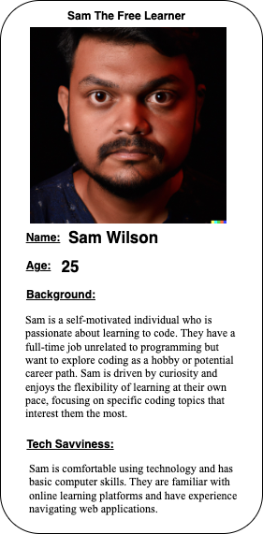
The Free Learner
Can generate questions based on personal proficiency, language, and topic
Can view progress and topic related analytics through a user dashboard
Can manage profile settings, styles and public information
Notes:
The free learner user type is able to generate their own questions, this user type is one who is looking to improve their coding skills and stay up to date with industry standards. The student user is afforded the same functionality as the free learner but these users are enrolled in class (either high school or university level), the system will be utilized to help them better understand course content all while improving their programming skill set. The instructor user type is looking for a platform to easily generate assignment questions that

Slide 8
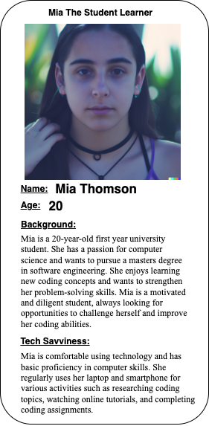
The Student Learner
Can generate questions based on personal proficiency, language, and topic
Can view personal progress and class related analytics through a user dashboard
Can manage profile settings, styles and public information
Can join a class (via class code)
Can answer assignment questions created by the instructor

Slide 9
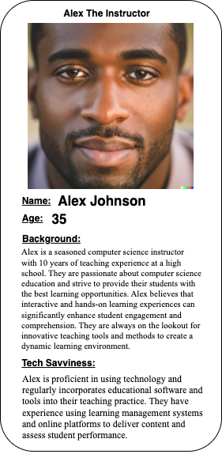
The Instructor
Can create classes with class codes
Can generate assignments with questions based on proficiency, language, and topics best suited for course curriculum
Can view student progress, question completion and class analytics through classroom dashboards.

Slide 10
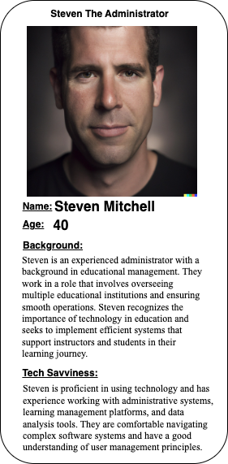
The Administrator
Can create institutions with institution codes
Can view institution analytics
Can remove/edit users, courses, and institutions

Slide 11
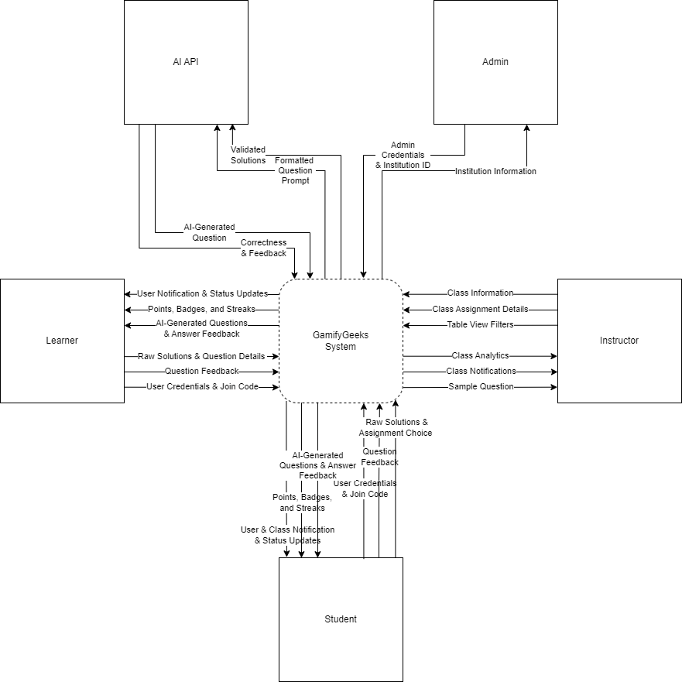
Level 0 DFD
Notes:
We are starting off the data flow diagrams with level 0. Here is the basic overview of the system as a single boundary. We can see here its relationship with 5 external entities, 4 of which are user groups, and the last one is the AI API. We can see the simple exchange of data between the system and the entities. Before going into too much detail, you may notice the large overlap in student and learner data. This is because students can simply be thought of as learners specific to a classroom. Notably though, the student chooses assignments, not questions as that is the responsibility of the instructor. They also receive things specific to them such as class notifications.

Slide 12
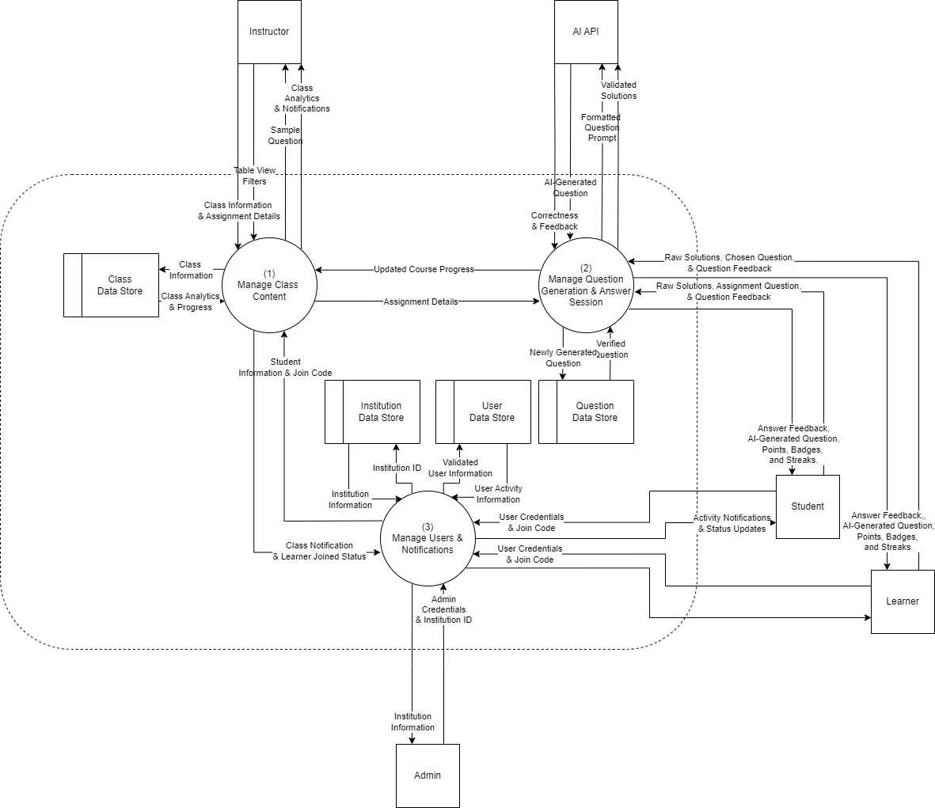
Level 1 DFD
Notes:
Going deeper into the data flow diagrams to level 1. We've expanded the single system boundary to the 3 major processes being the class, user, and question processes. This also shows the appropriate data stores interacting with each of the processes mainly the class, user, question, and institution data stores. We can see from this that the students and learners interact mainly with the question process to provide their answers and receive feedback or rewards as a result. There is also the 3 level 2 data flow diagrams that further expand on these 3 processes but we won't have time to fully discuss them today.

Slide 13
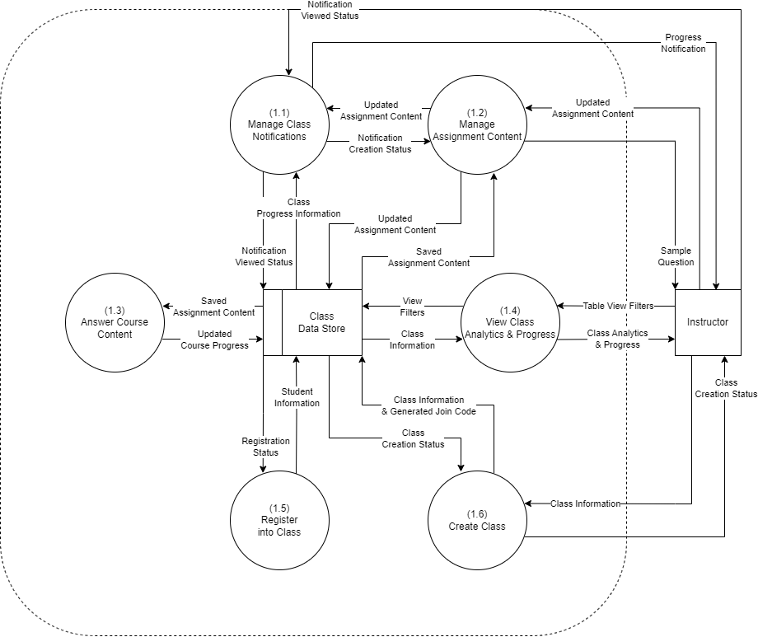
Level 2 DFD
(Class)
Notes:
Going deeper into the data flow diagrams to level 1. We've expanded the single system boundary to the 3 major processes being the class, user, and question processes. This also shows the appropriate data stores interacting with each of the processes mainly the class, user, question, and institution data stores. We can see from this that the students and learners interact mainly with the question process to provide their answers and receive feedback or rewards as a result. There is also the 3 level 2 data flow diagrams that further expand on these 3 processes but we won't have time to fully discuss them today.

Slide 14
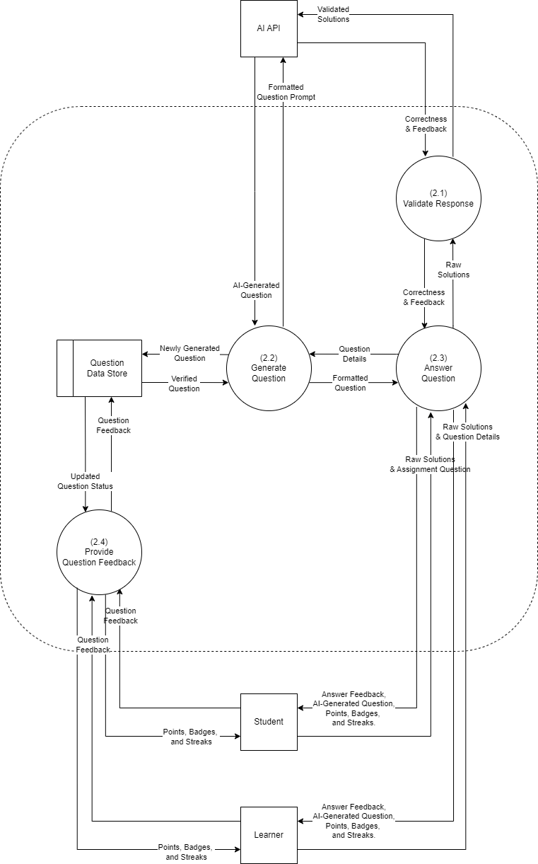
Level 2 DFD
(Question)
Notes:
Going deeper into the data flow diagrams to level 1. We've expanded the single system boundary to the 3 major processes being the class, user, and question processes. This also shows the appropriate data stores interacting with each of the processes mainly the class, user, question, and institution data stores. We can see from this that the students and learners interact mainly with the question process to provide their answers and receive feedback or rewards as a result. There is also the 3 level 2 data flow diagrams that further expand on these 3 processes but we won't have time to fully discuss them today.

Slide 15
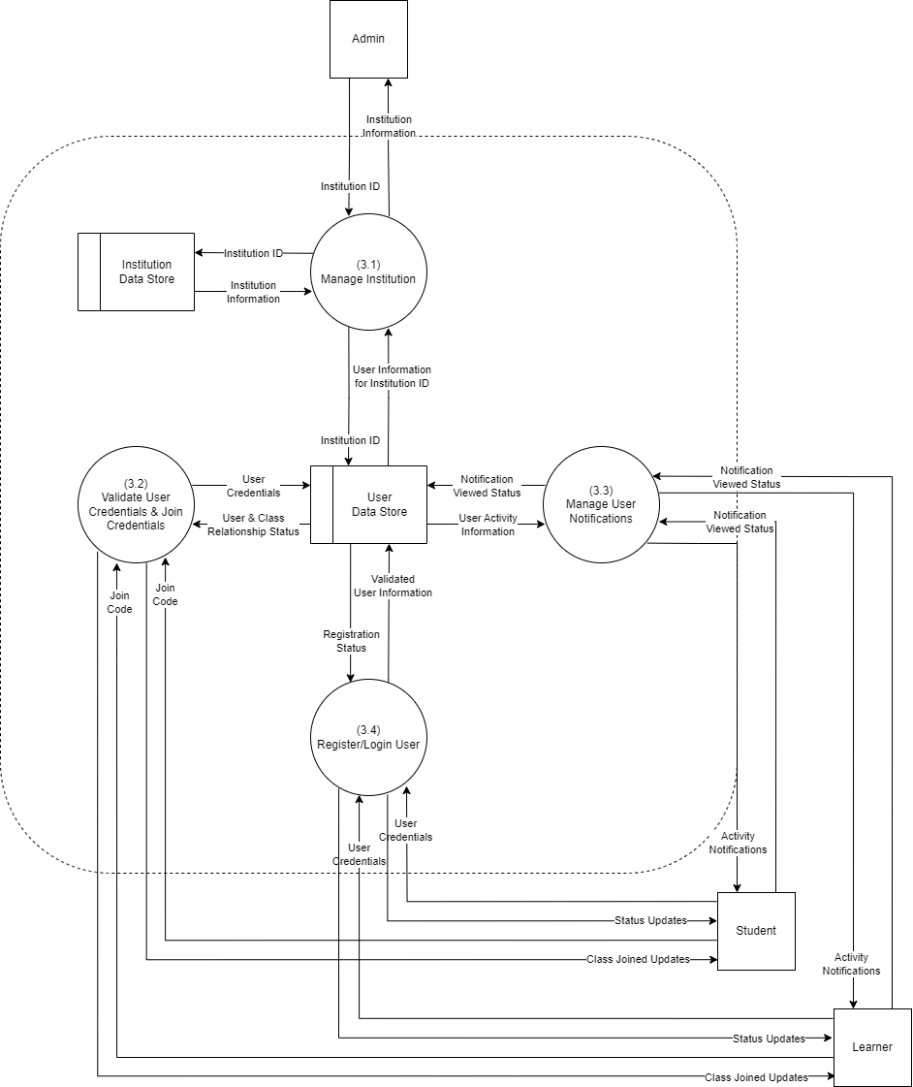
Level 2 DFD
(User)
Notes:
Going deeper into the data flow diagrams to level 1. We've expanded the single system boundary to the 3 major processes being the class, user, and question processes. This also shows the appropriate data stores interacting with each of the processes mainly the class, user, question, and institution data stores. We can see from this that the students and learners interact mainly with the question process to provide their answers and receive feedback or rewards as a result. There is also the 3 level 2 data flow diagrams that further expand on these 3 processes but we won't have time to fully discuss them today.

Slide 16
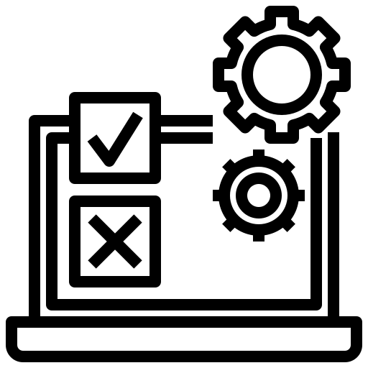
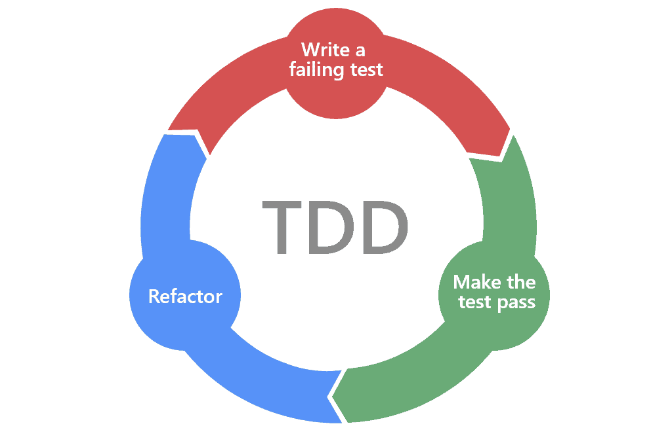
Testing Methodologies
Test-Driven Development (TDD)
Automated Regression & Unit Testing
Integration Testing
Usability Testing & User Acceptance Testing
Attr: Marsner Technologies SRL, https://marsner.com/blog/why-test-driven-development-tdd/
Notes:
With TDD, test driven development,
The process is going to be:
First Develop a test for one step of code
then iterate Writing code and running test till have test pass
Once, code pass the test then refactor it.
Loop back and move onto a next test/feature.
repeat this for every step
Automated Regression & Unit Testing: Utilize GitHub Actions workflow for it. And use Jest for both client and server testing, following a TDD approach (for high cohesion and low coupling).
Integration Testing: validate server-side APIs and client-side UI, test database interactions, and incorporate tests into the CI/CD process.
Usability Testing: Define user profiles, create test scenarios, recruit participants, conduct tests and gather data, then analyze it and make improvement for usability issues.
User Acceptance Testing (UAT): Identify test scenarios, prepare test users, execute tests, observe results, resolve issues, and repeat this process until the system meets user expectations and business requirements enough.
With TDD, the goal is to:
Develop the test for one small part of code (small steps)
Run test (the test should fail as we haven't written the actual code yet...)
Write code to fix and have test pass
Refactor (remove duplication and streamline testing)
Loop back and move onto next test/feature.
Automated Regression & Unit Testing: Utilize GitHub Actions workflow for automated regression testing, incorporating unit, integration, and system tests. For unit testing, implement Jest for front-end and back-end testing, and follow a test-driven development approach for high cohesion and low coupling.
Integration Testing: Establish a test environment, conduct end-to-end user scenario testing, validate server-side APIs and client-side UI, test database interactions, and incorporate tests into the CI/CD process. Bugs discovered should be reported for resolution.
Usability Testing: Define user profiles, create test scenarios, recruit participants, set up test environments, conduct tests and gather data, then analyze this data for usability issues. Make necessary improvements and iterations based on feedback.
User Acceptance Testing (UAT): Conduct structured UAT before major system releases to validate system requirements and usability. Identify test scenarios, prepare test users, execute tests, observe results, resolve issues, and repeat the process until the system meets user expectations and business requirements.

Slide 17

Conclusion
Thank you for listening!
Questions?
:)

